Slide 1

CSE 163
Images + Machine Learning
Hunter Schafer

Slide 2
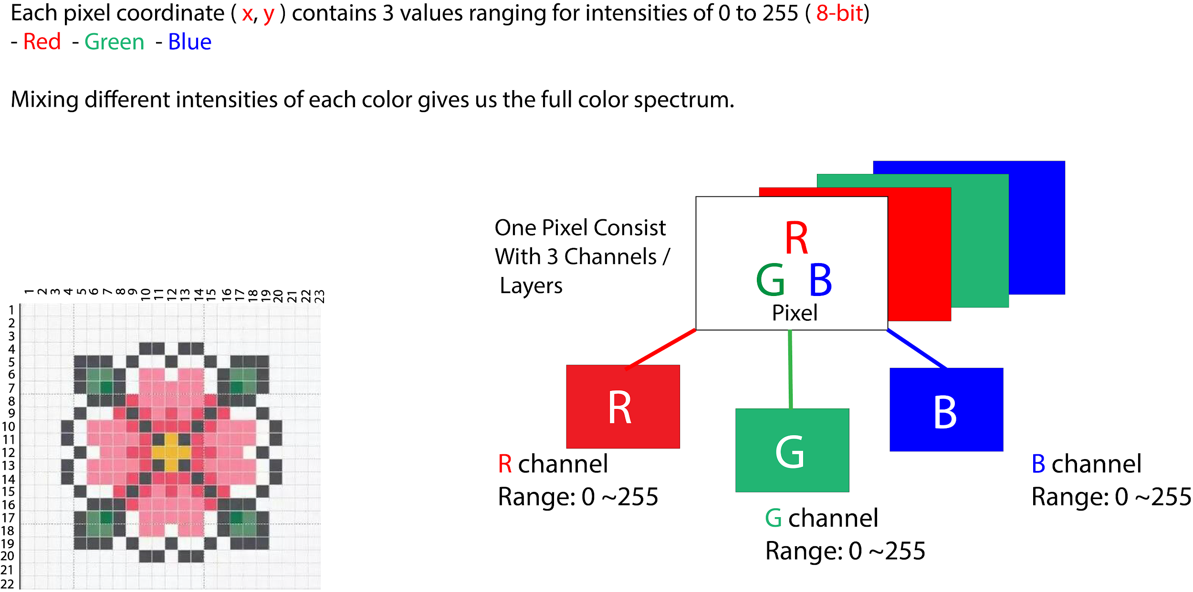
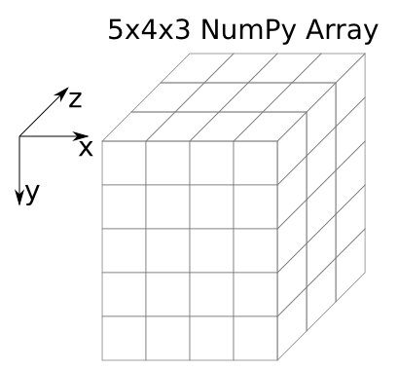
Color Images

Slide 3
Convolution
When wanting to use “local” information, we need to use a sliding window approach (i.e. a convolution)
Move the sliding window across the image, and compute the sum of the element wise product of the window (kernel) and image
Image
3 | 3 | 2 | 1 | 0
0 | 0 | 1 | 3 | 1
3 | 1 | 2 | 2 | 3
2 | 0 | 0 | 2 | 2
2 | 0 | 0 | 0 | 1
Kernel
0 | 1 | 2
2 | 2 | 0
0 | 1 | 2

Slide 4
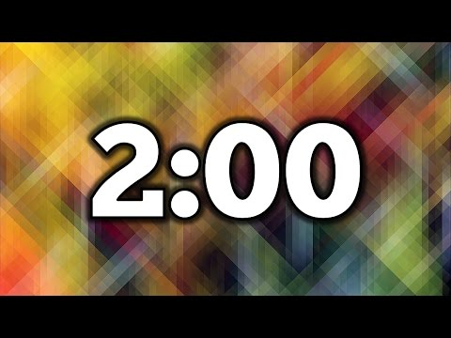
1 minute
What is the result of applying a convolution using this kernel on this image?
Image
Kernel
1 | 2 | 3
4 | 5 | 6
7 | 8 | 9
1 | 2

Slide 5
1.5 minutes
What is the result of applying a convolution using this kernel on this image?
Image
Kernel
1 | 2 | 3
4 | 5 | 6
7 | 8 | 9
1 | 2

Slide 6
Machine Learning
Remember back to the land of machine learning
We have some data which we map to features and labels
We use a machine learning algorithm to train a model on that data
One major goal of machine learning is to produce a model that is accurate on future data.
This is why we need that test set to help us validate our model

Slide 7
ML + Images
How do we do machine learning on images?
Simplest: Unroll the image into a vector
Complex: Use other tools to extract features from the images
10
20
30
40
50
60
70
80
90
Raw Image
10 | 20 | 30
40 | 50 | 60
70 | 80 | 90
Unrolled Image

Slide 8
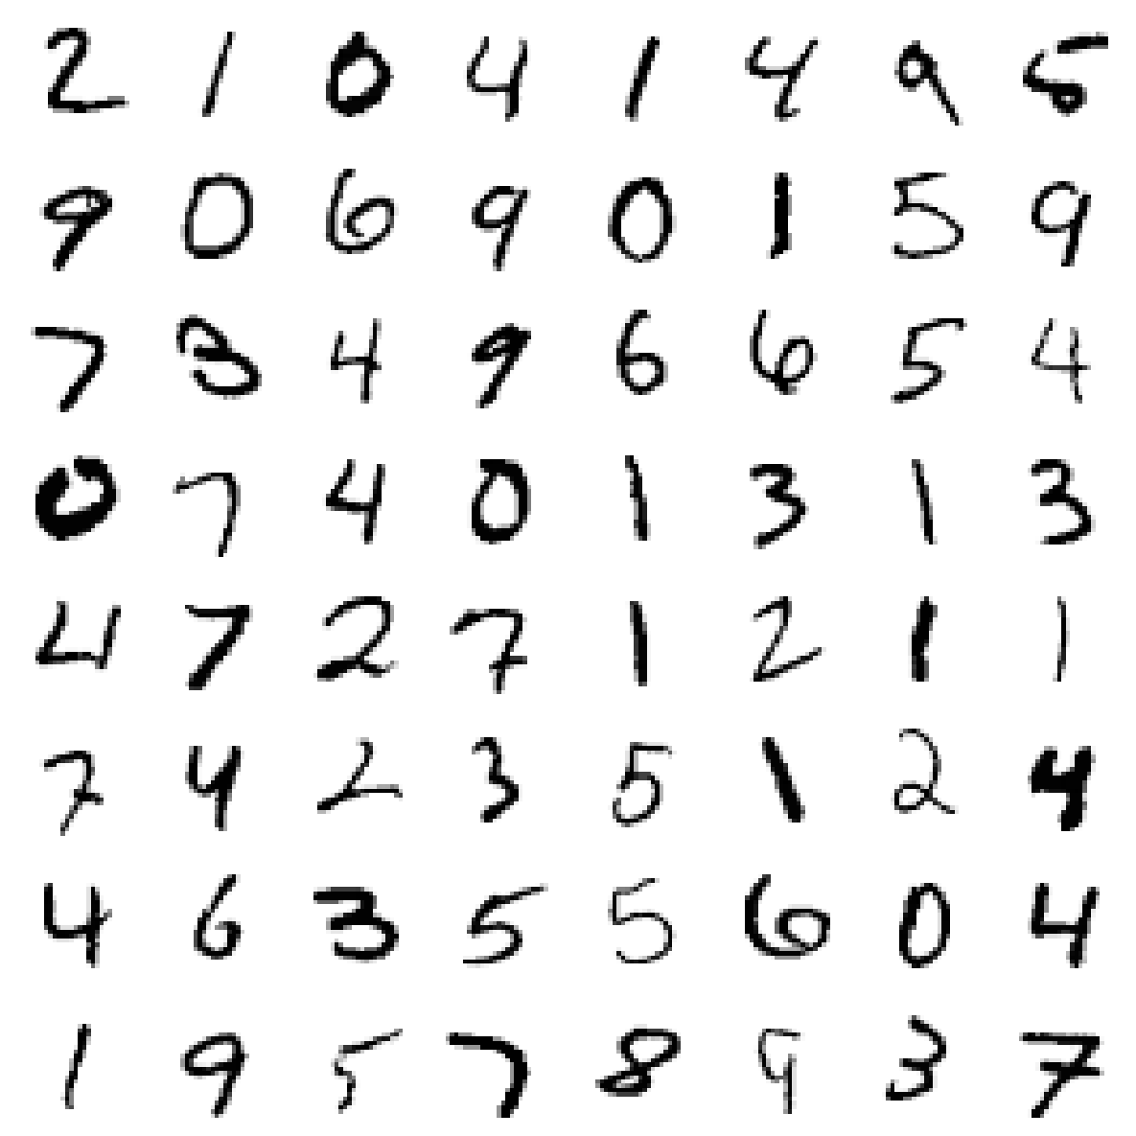
ML + Images
Pros: Simple transformation (just a call to reshape!)
Cons: It loses the idea of “neighboring” pixels (up/down)
Most machine learning models don’t take position of the features into account
This is where more complex models like convolutional neural networks come in to encode that local information as features
Despite these drawbacks, it can work in practice on some problems!

Slide 9
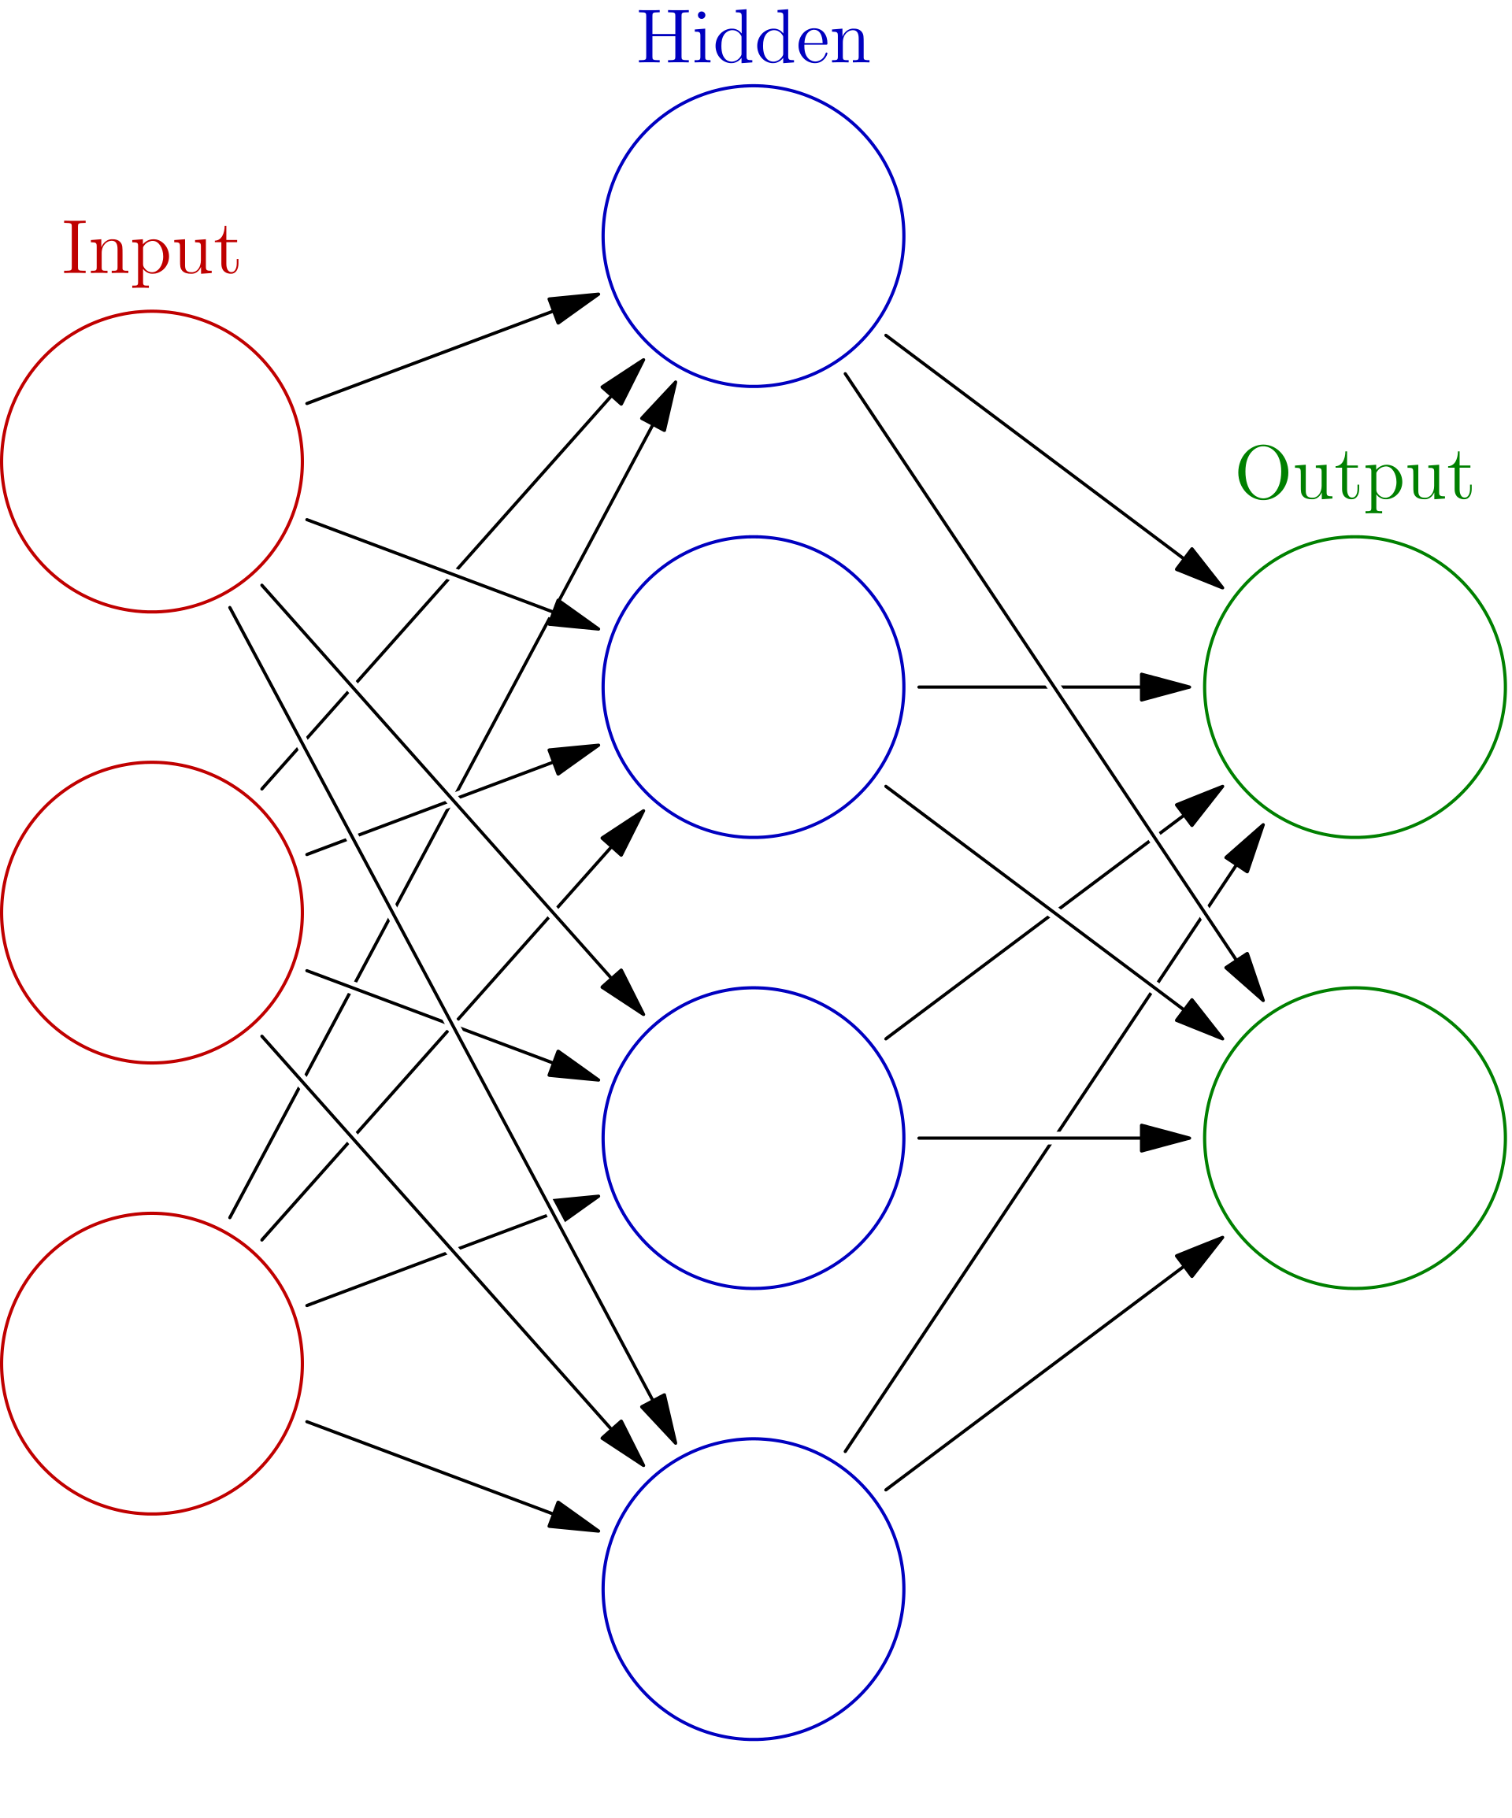
Neural Network
Based on how our brains work

Slide 10
MNIST
Colab
MNIST is a dataset of handwritten digits and their labels
Very popular starter project with images and ML
Lots of hyper-parameters to specify in the model!
Learning Rate
Number of hidden layers
Number of hidden nodes

Slide 11
Unsupervised
Learning
So far, we have seen supervised machine learning, where we have to explicitly shown the algorithm the labels
Unsupervised machine learning lets the algorithm try to learn trends on its own without providing explicit labels
Examples
Clustering
Outlier detection

Slide 12
Clustering (k-means)

Slide 13
Blob Detection
Colab
Library: scikit-image
Blob Detection

